Slide 1
Predicting Customer Churn for SyriaTel
Name: Margret Nyairo
Date: 6/12/2024

Slide 2
Introduction
Objective: Analyze customer data for churn patterns.
Focus: Identify key factors influencing churn.
Methods: Data visualization and analysis techniques.
Features: Usage metrics, service plans, demographics.
Goal: Develop strategies to improve customer retention.
Outcome: Data-driven insights for decision-making.
Importance: Enhance understanding of customer behavior.

Slide 3
Data Exploration
State Data: No unexpected values.
Binary Features: Convert international_plan, voice_mail_plan to boolean.
Area Codes: Analyze churn by area code.
Phone Number: Likely irrelevant, may drop.
Account Length: Represents days with the company.
Voicemail Messages: Keep, potential churn indicator.
Service Calls: No abnormal values observed.

Slide 4
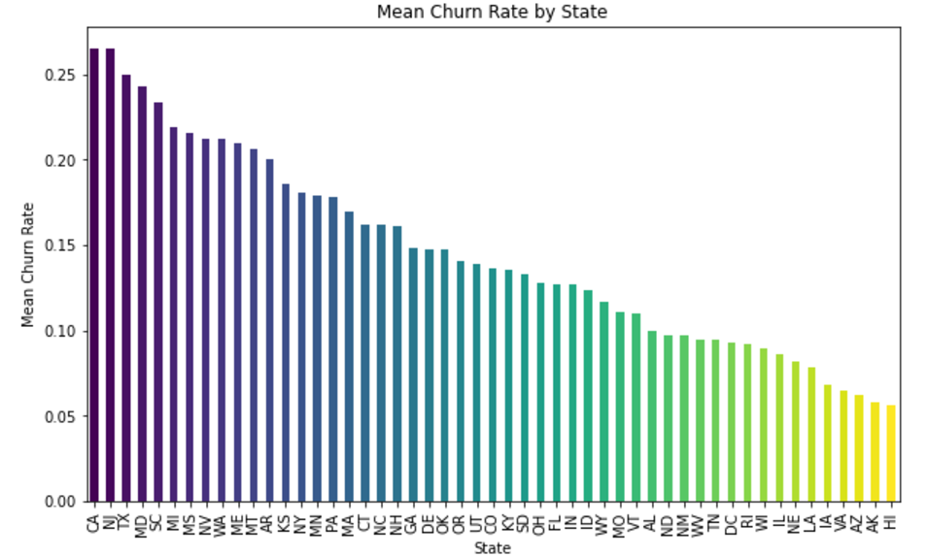
Visualizations

Slide 5
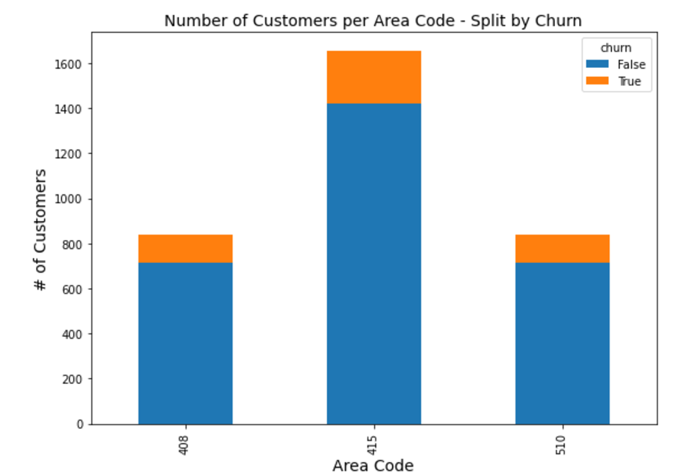
Number of Customers Per Area Code - Split by Churn

Slide 6
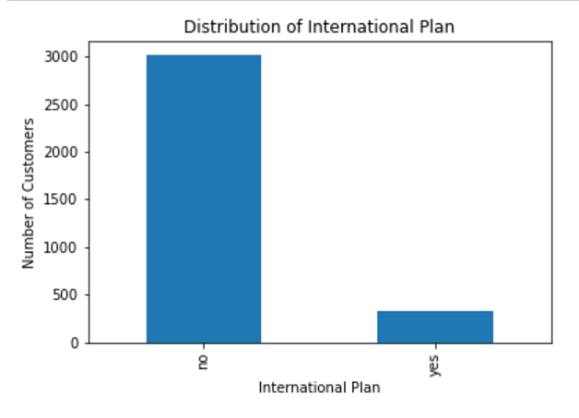
Distribution of International Plan

Slide 7
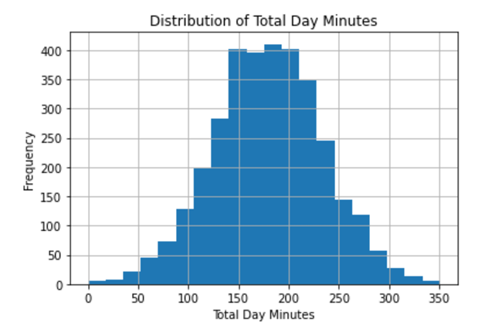
Distribution of Total Day Minutes

Slide 8
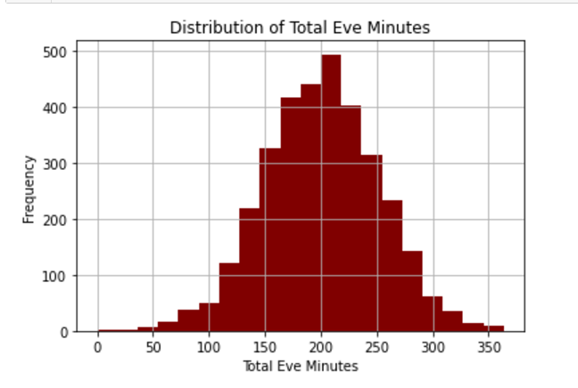
Distribution of Total Eve Minutes

Slide 9
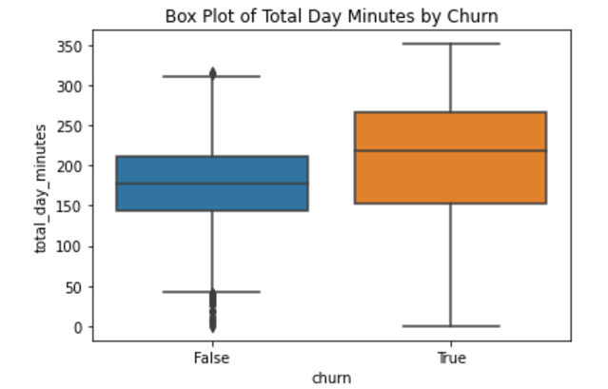
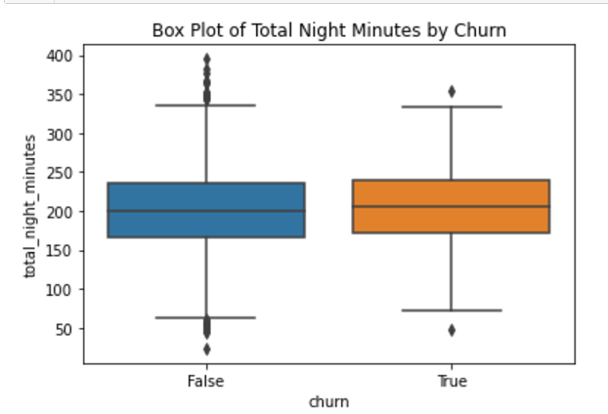
Box Plot of Total Day Minutes by Churn & Box Plot of Total Night Minutes by Churn

Slide 10
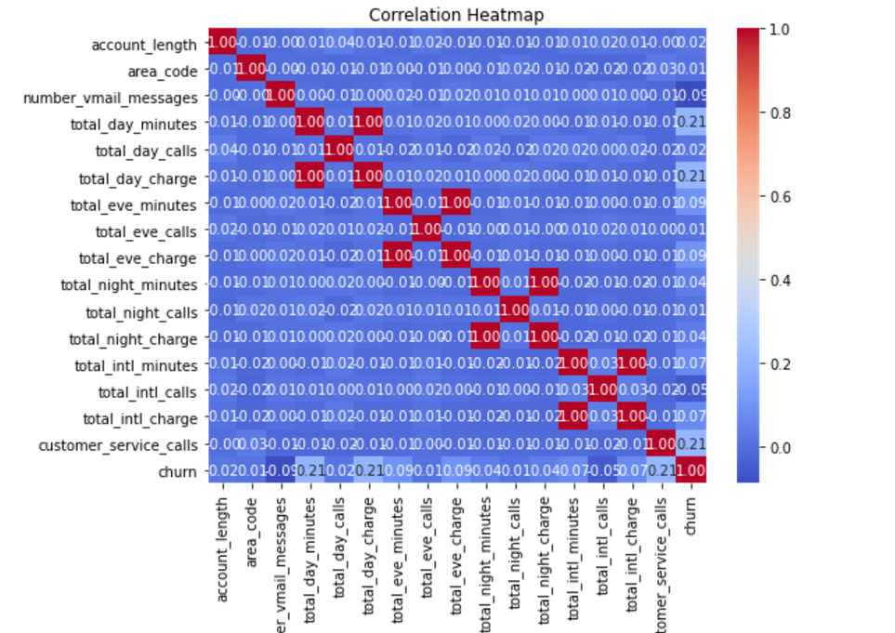
Correlation Heatmap

Slide 11
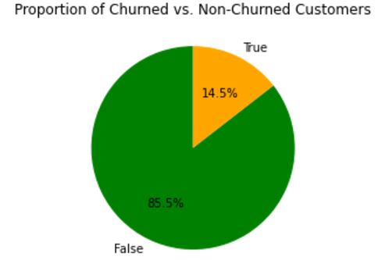
Proportion of Churned vs. Non-Churned Customers

Slide 12
Analysis
Key Factors Identified:
Analyzed usage metrics, service plans, and demographics.
Identified patterns leading to customer churn.
Visual Insights:
Highlighted areas of high churn.
Pinpointed specific regions and customer segments for targeted interventions.
Correlation Analysis:
Understood relationships between features and churn.
Guided feature selection for predictive modeling.
Data Preparation:
Converted binary features.
Assessed the relevance of different columns.
Modeling:
Implemented various machine learning models.
Evaluated model performance using accuracy, precision, and recall metrics.
Selected the best-performing model for churn prediction.

Slide 13
Conclusions
Predictive Models: Built to identify at-risk customers for SyriaTel.
Best Model: Decision Tree model with 93% accuracy.
Data Enhancement: Feature engineering and EDA improved dataset quality.
Outcome: Provides actionable insights for improving customer retention.

Slide 14
Recommendations
To enhance customer satisfaction and reduce churn, stakeholders should:
Implement targeted marketing campaigns and personalized offers for at-risk customers.
Offer proactive support and improved training for customer service representatives which are crucial in assisting customers.
Gather and act on customer feedback to drive product and service improvements.
Increase customer engagement through personalized communication and maintaining transparency in billing to build trust and satisfaction.
Regular monitoring and updating the churn prediction model to ensure its accuracy, allowing for data-driven decisions. Foster cross-departmental collaboration and exploring partnerships to add value and strengthen customer retention efforts.

Slide 15
Thank You!
Email: margret.nyairo@student.moringaschool.com
Github: vidya-byte

